Slide 1
UNIVERSAL 1/r² POTENTIALS at short and long range avoids collapse holds quasi-bound states
A. R. P. Rau
Department of Physics and Astronomy
Louisiana State University, Baton Rouge
Ph. D. U of Chicago, 1970, Ugo Fano, 3-body Coulomb threshold laws, Doubly-excited
states of H⁻⁻ and He, ….. nuclear 3-body ²⁰C: ¹⁸C + n + n, ….
B.Sc. (Hons) 1964, M. Sc. 1966, U of Delhi
A. N. Mitra, Mathematical Physics, Quantum Field Theory
F. C. Auluck, S. N. Biswas, L. S. Kothari, V. S. Mathur, M. L. Mehta, N. Panchapakesan, R. K. Pathria, R. P. Saxena, P. K. Srivastava, …

Slide 2
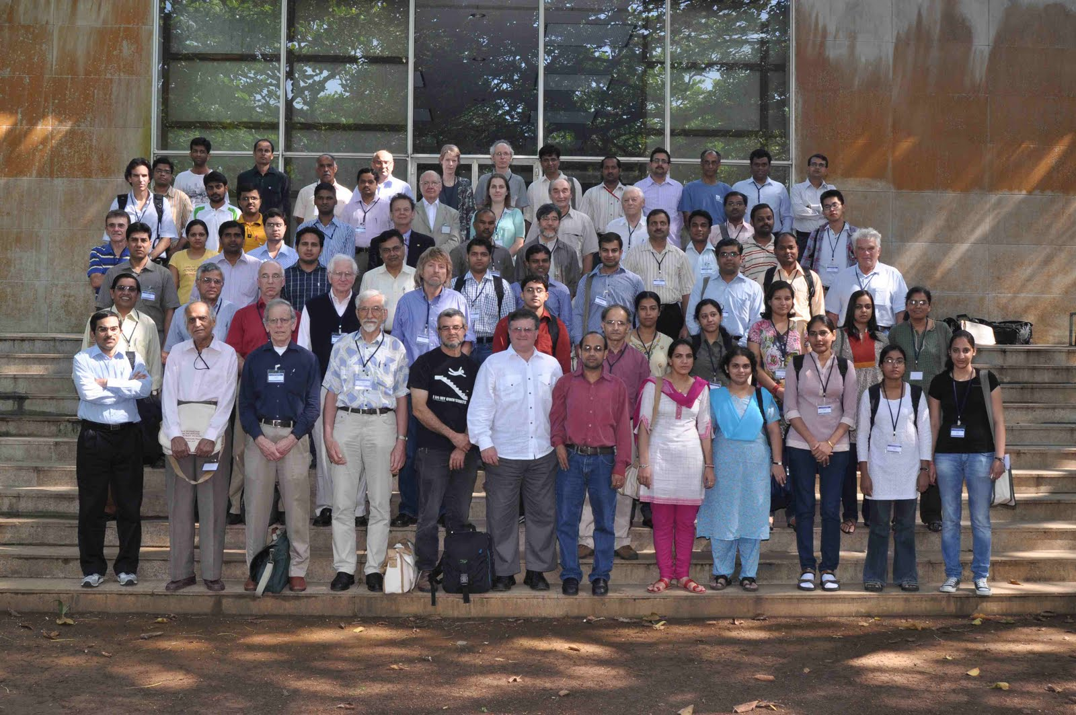
TIFR, Nov 2010, N-N Interactions and Nuclear Many-Body Problem

Slide 3
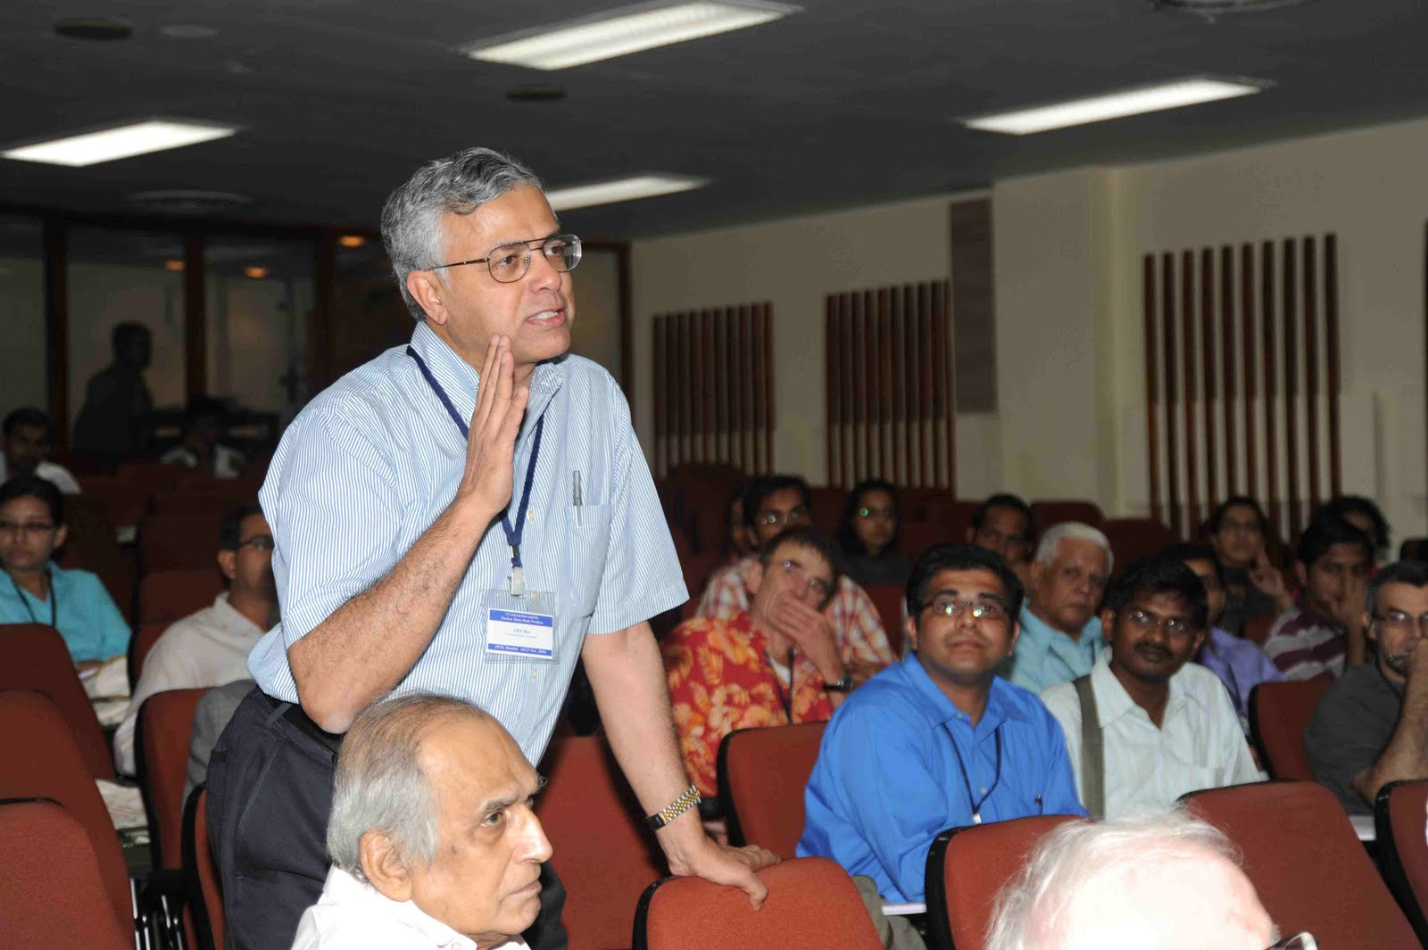
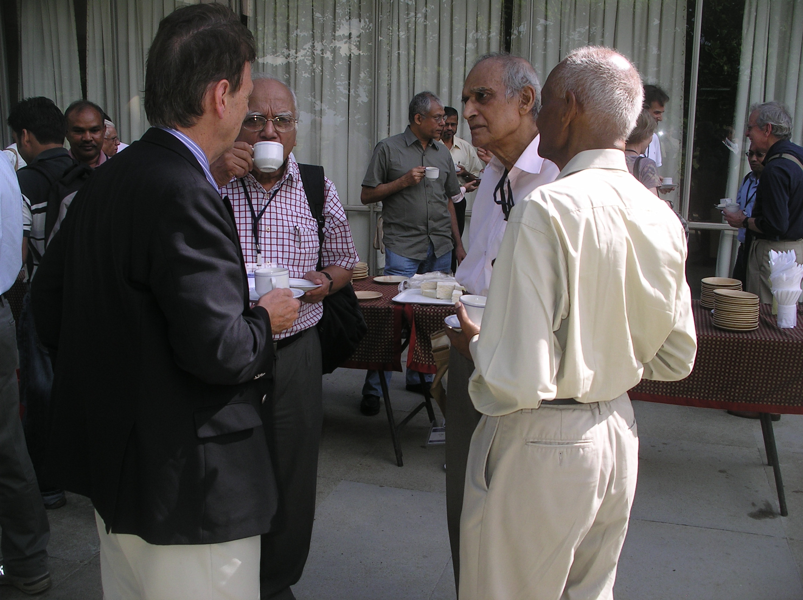
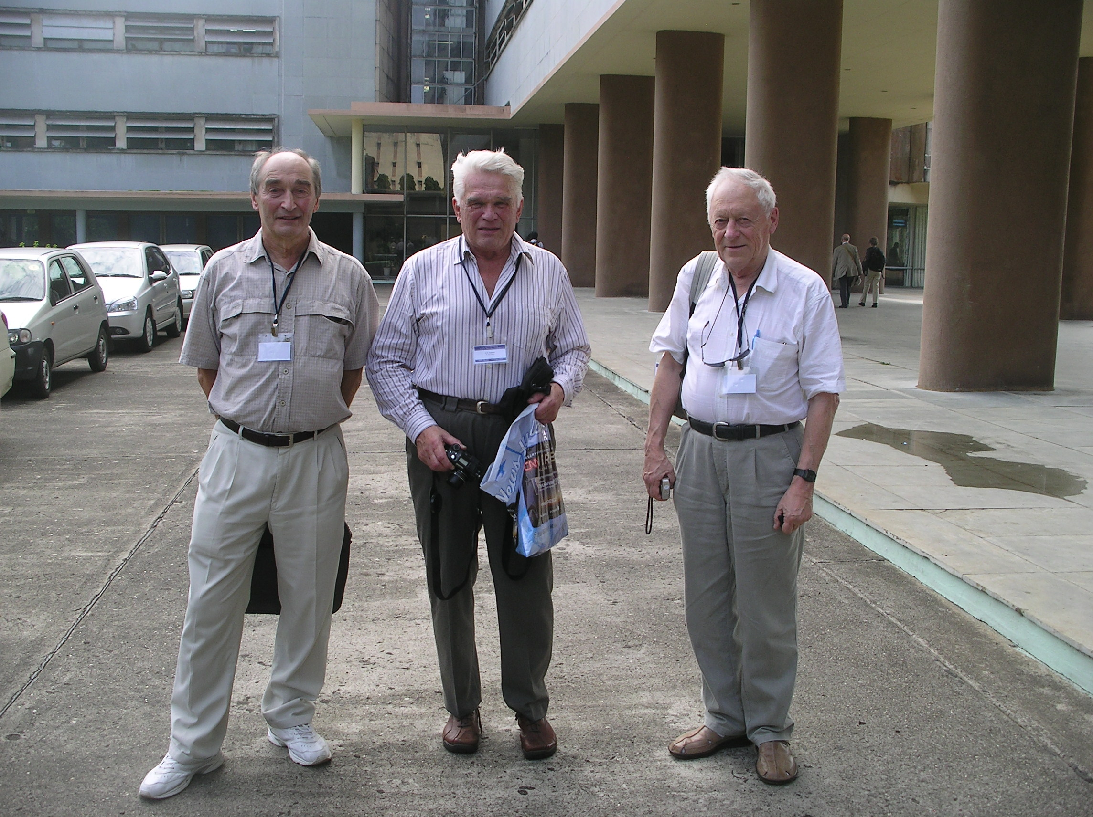
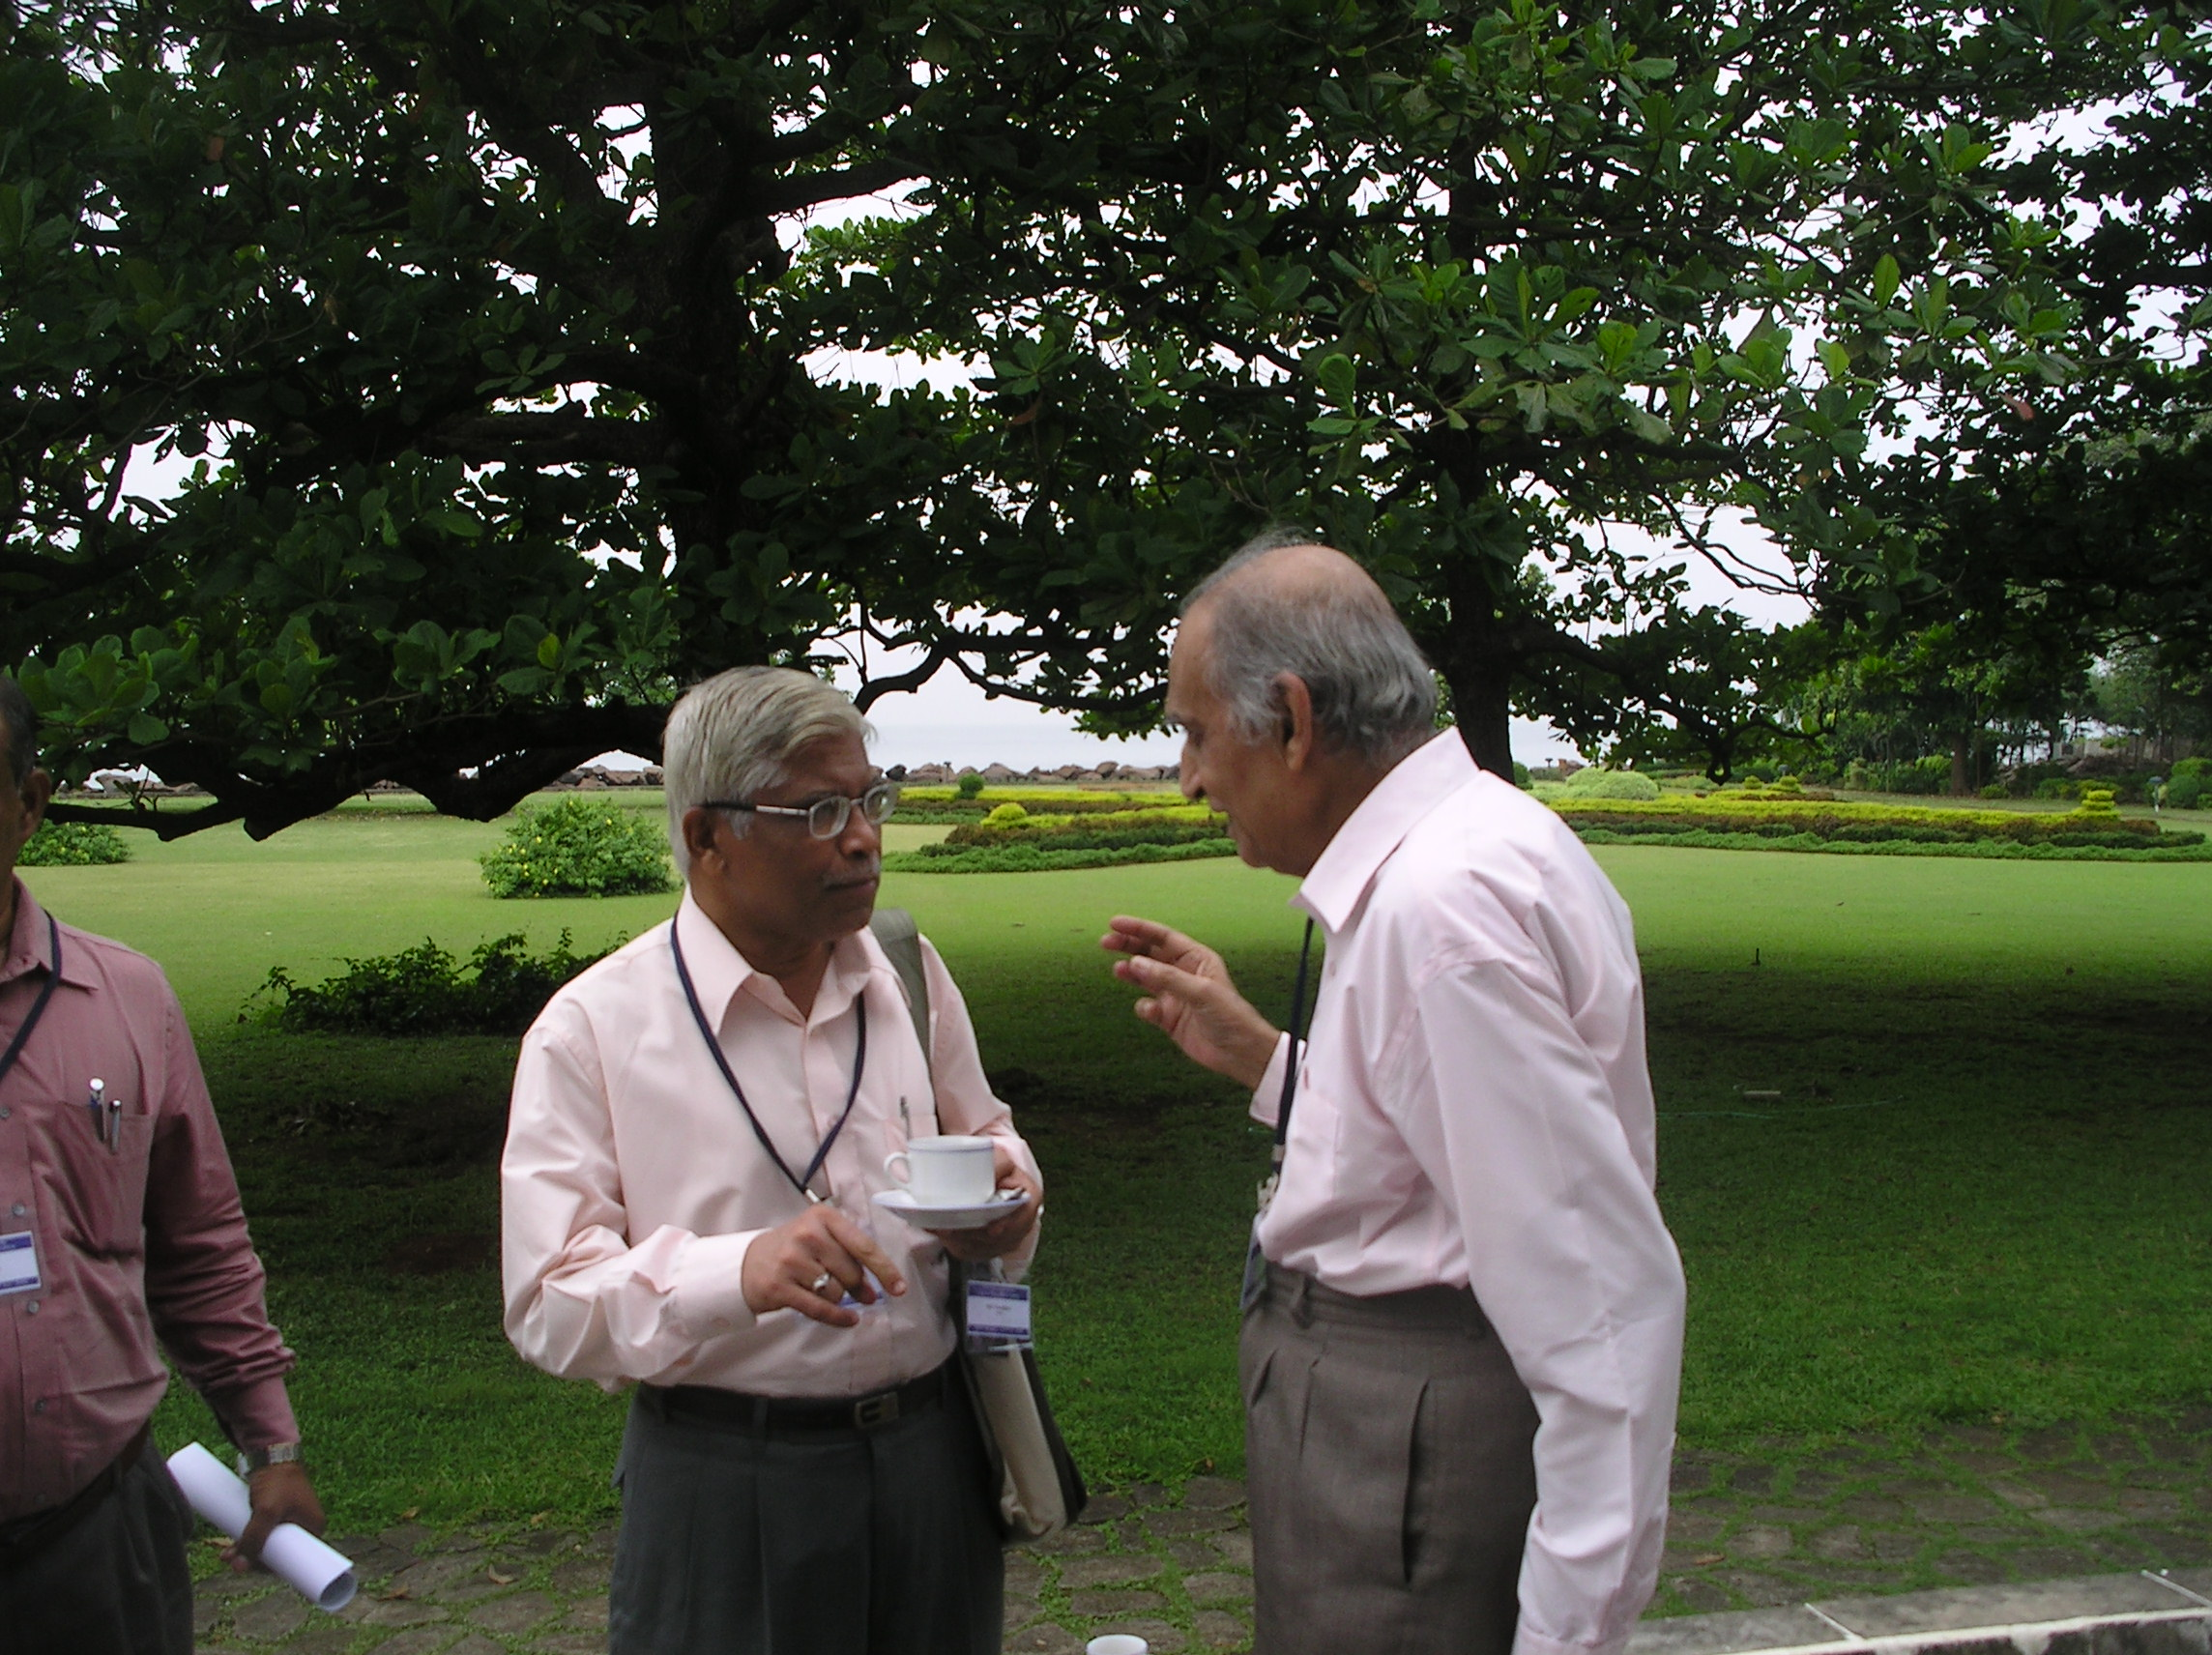
Vary Mitra Warke
Efimov, Faddeev, Belyaev

Slide 4
Themes:
Quantum binding, 1/r² potentials at small and large r
Attractive dipole 1/r² potential - bound states
Resonances: asymmetric “Fano” profiles
Scattering length, and its tuning
Neutron rich species: n + n + A
Universal aspects: atomic, molecular, nuclear

Slide 5
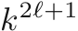
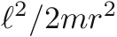
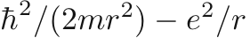
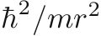
Angular Kinetic Energy
Repulsive barrier: at small r avoids collapse, at large r holds
low energy particles from penetration and/or escape
Classical Physics: Collapse for straight line
Quantum Physics, always an
radial kinetic energy
Stability of H atom Bohr radius a₀
Wigner Threshold Law tunneling at large r

Slide 6
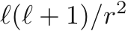
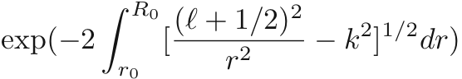
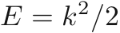
Tunneling through angular potential barrier
V
r₀
r
R₀
elastic scattering phaseshift
inelastic cross-section

Slide 7
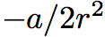
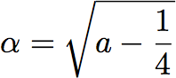
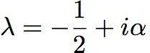
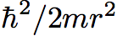
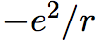
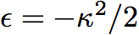
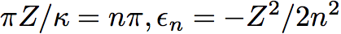
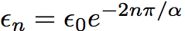
Attractive potential, effective complex angular momentum
Number of bound states: Infinite number for long range
vs
1/r² the dividing falloff between long/short range, infinite/finite #
for 1/r² itself, the strength parameter a decides
Infinite sequence described by sin ( ) = 0 => eigenvalues
Coulomb :
Dipole bound states: molecules (OH, H₂O), H atom in n > 1 :

Slide 8
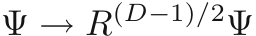
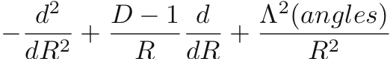
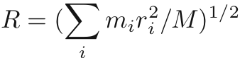
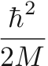
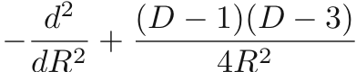
D-dimensional Laplacian:
radial angular
N – body problem : D = 3(N-1) three-body: 6
R² = r₁² + r₂² + ….. R overall size of the system, remainder angles
radial kinematic potential
D = 2 attractive
D > 3 repulsive
Universal, reflecting all but one R coordinate, “hard-sphere” at small R, long range tail

Slide 9
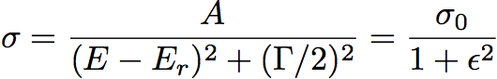
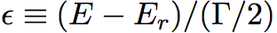
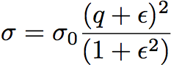
Resonances in physics: symmetric Lorentzian shapes
Breit-Wigner in nuclear and particle physics
Fano (1961) resonance as interference between two pathways
Fano profile, asymmetric, zero at
Reduces to Lorentzian for

Slide 10
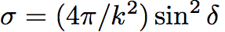
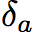
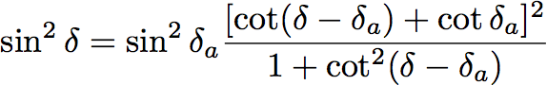
Elastic scattering
background
= 0,
reduces to Lorentzian

Slide 11
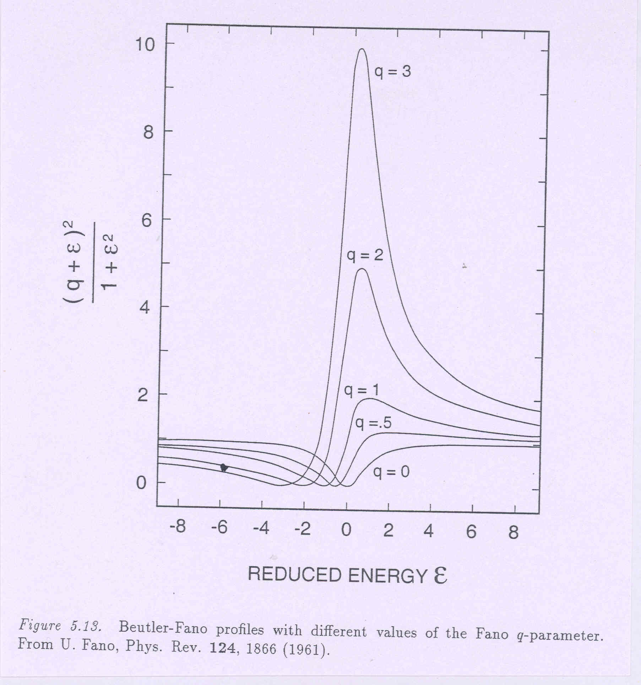

Slide 12
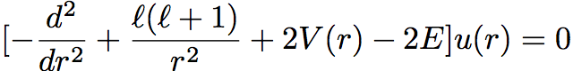
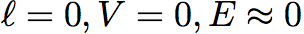
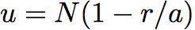
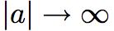
Scattering length: s-wave
------ E -----
0 r
--------------
only scattering state
0
possible bound state as well
boundary for binding
weak binding: very large spread of wave function, e.g. deuteron, H⁻⁻

Slide 13
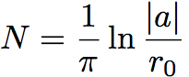
V. Efimov, Phys. Lett. 33B, 563 (1970) L.H.Thomas (1935)
Two-body with range r₀
Effective 1/R² potential as scattering length gets large
As two-body binding increases, Efimov states disappear
Excited state of helium trimer ⁴He₃; ⁴He₂ weakly bound
Cold atom traps, magnetic tuning of atom-atom scattering length. Cesium atoms through van der Waals, r₀ =100 a₀ Tune a between -2500 and 1600 a₀ 10 nK
Kraemer et al, Nature 440, 315 (2006); Esry-Greene, p.289

Slide 14
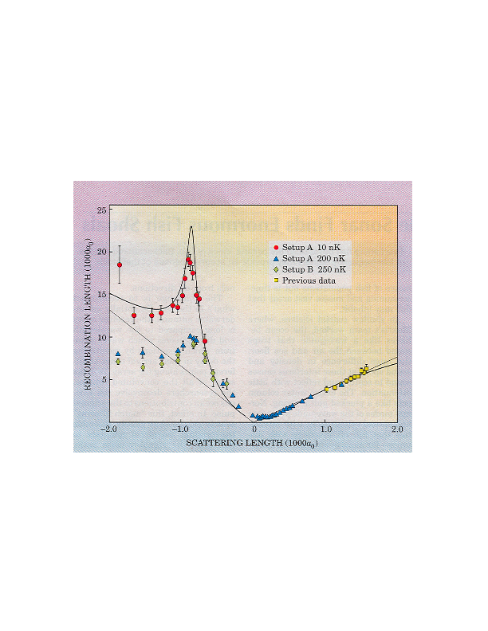
Efimov states of Cesium trimers
Kraemer et al, Nature 440, 315 (2006), Esry-Greene, p.289
C. H. Greene, Phys. Today 63 (3), 40 (2010)

Slide 15
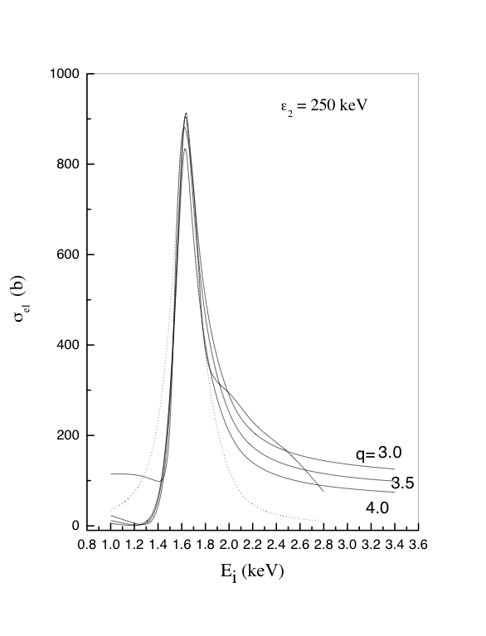
I.Mazumdar, ARPR, V.S.Bhasin, Phys.Rev.Lett. 97,062503 (2006)
neutron-rich, halo nuclei. ²⁰C : n + n + ¹⁸C
two-body energy ¹⁹C tuned
elastic n + ¹⁹C cross-section for energy E_{i}
E_{r} =1.63 keV
= 0.25 keV
q = 4

Slide 16
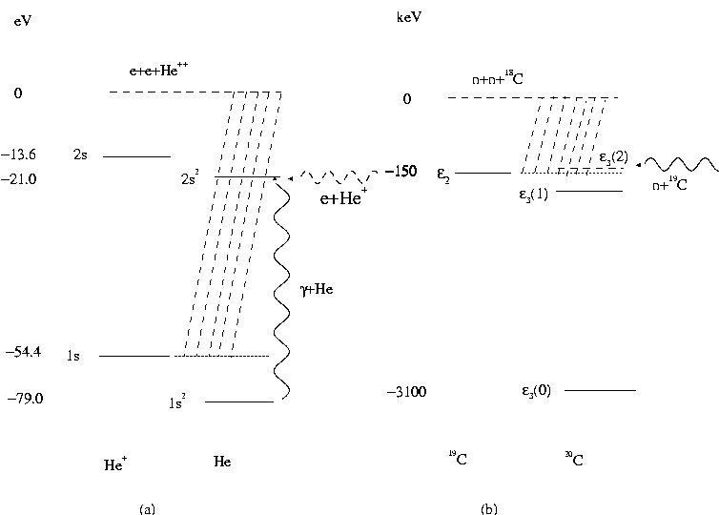
Doubly-excited He
Two-neutron states in nuclei

Slide 17
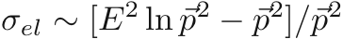
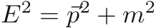
N – N Potential Repulsive Barrier/Core at small R
U. Fano Wannier 3-body threshold law with Coulomb
H⁺ + e + e
Repulsive 1/R² Potential
at small R
R
Not really a two-body but an effective potential of a many-
body system
Number of particles not defined, a conjugate phase as in BCS
Born approximation:

